Slide 1
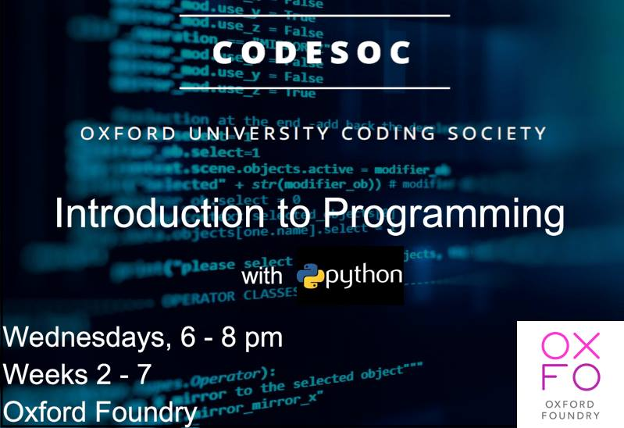

Slide 2
First half topics:
- Review Loops
Functions
Importing Modules and documentation
Notes:
So last week, ya’ll were quite happy about the level of programming. This week, we’ll continue with roughly the same type of material for the first half,

Slide 3
First half topics:
- Review Loops
Functions
Importing Modules and documentation
Second Half Topics
High-level programming
Webscraping
- SMTP (Email Sending)
Notes:
and then we’ll move on to some significantly harder stuff.

Slide 4

First half topics:
- Review Loops
Functions
Importing Modules and documentation
Second Half Topics
High-level programming
Webscraping
- SMTP (Email Sending)
Notes:
What I want you to know is that the first half of what we are doing is principally important!
As a programmer, you will need these tools to do anything you do in the future. Loops, functions, importing modules, and documentation are key to doing anything as a programmer. And what we do in the future will build off of this

Slide 5
First half topics:
- Review Loops
Functions
Importing Modules and documentation
Second Half Topics
High-level programming
Webscraping
- SMTP (Email Sending)
Notes:
For the Second half of this presentation today, we’ll try some stuff that is pretty task-specific. If you get lost, that’s fine. It’s tough material, and we will not be building off of what we cover in the second half.
Is that cool?

Slide 6
So again we’re going to copy from GitHub and Open jupyter notebook.
https://github.com/OxCodeLaborate/IntroToPython

Slide 7
Loops!
Notes:
Try opening up your loop exercises.

Slide 8
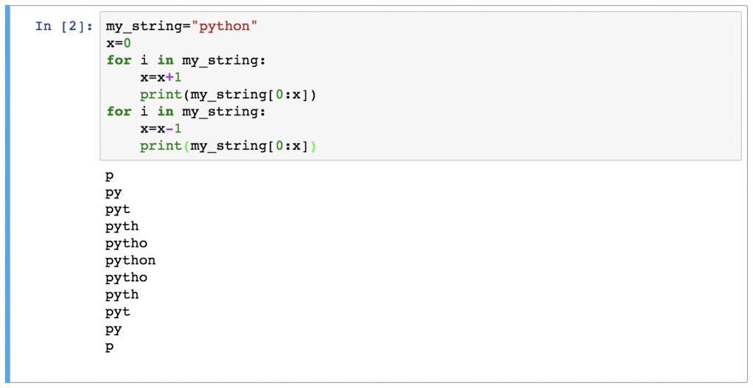
Open Week 4 Part 1
Notes:
Try opening up your loop exercises.

Slide 9
Additional Loop Challenges if you finish the provided ones:
Find the unique characters in a string.
Write a program to swap the first occurrence of the max value of a list of numbers, with the first occurrence of the min value

Slide 10
Functions!

Slide 11
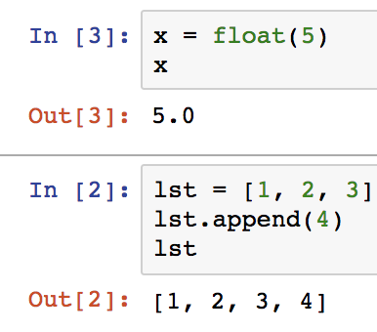
Notes:
These are functions. We’ve used them before. Now we’re going to take Python one step further, and build them ourselves.

Slide 12

Writing a function. Why?
Notes:
Why would we want to do this? If we have a set of instructions that we think are particularly useful, we might want to use it multiple times.
We only have to write a function once, and then we can use it as many times as we like.

Slide 13
Example:
- Write a Program that checks if two lists are anagrams

Slide 14
Write a Program that checks if two lists are anagrams

Slide 15
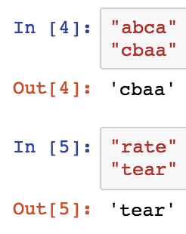
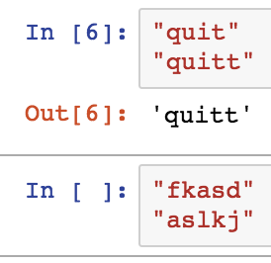
Write a Program that checks if two lists are anagrams
Anagrams
Not Anagrams

Slide 16
Write a Program that checks if two lists are anagrams
Game Plan:
-- Count the number of times each character occurs in each string.
– See if the counts for both strings are equal.

Slide 17
Write a Program that checks if two lists are anagrams
Game Plan:
-- Count the number of times each character occurs in each string.
– See if the counts for both strings are equal.
Notes:
But we are going to have to count the number of times each character occurs twice, one time for each string we are comparing.

Slide 18
Counts of Characters
string
dictionary
{’q’ : 1,
‘u’:1,
‘i’:1,
’t’:2}
“quitt”
Notes:
So we can write a function that generates the counts for us, like this.

Slide 19
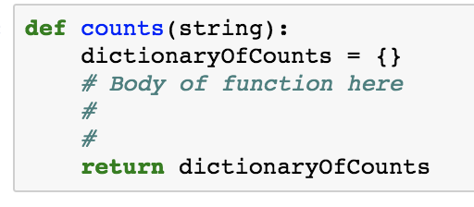
Counts of Characters
string
dictionary
{’q’ : 1,
‘u’:1,
‘i’:1,
’t’:2}
“quitt”
Notes:
And the syntax for defining such a function, looks like this

Slide 20

Counts of Characters
string
dictionary
{’q’ : 1,
‘u’:1,
‘i’:1,
’t’:2}
“quitt”
Notes:
And the syntax for calling this function, looks like this:

Slide 21
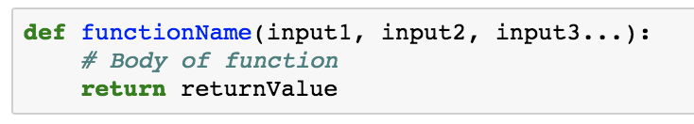
Notes:
Functions Can have multiple inputs if you like…

Slide 22
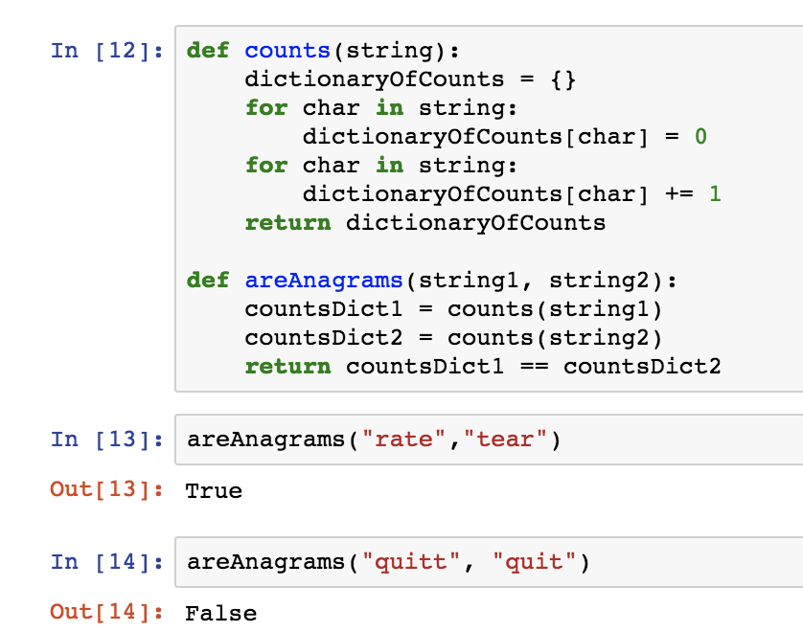
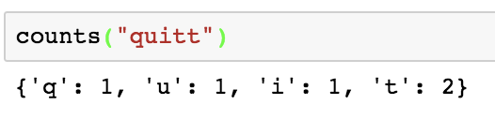
Notes:
And here’s some python code that solves the problem. The nice thing about breaking one problem down into multiple functions is that now you can easily test small snippets of code
[Talk about what each cell does]

Slide 23
Notes:
Also note that when we define a function, none of the code inside the function runs until we call it.

Slide 24
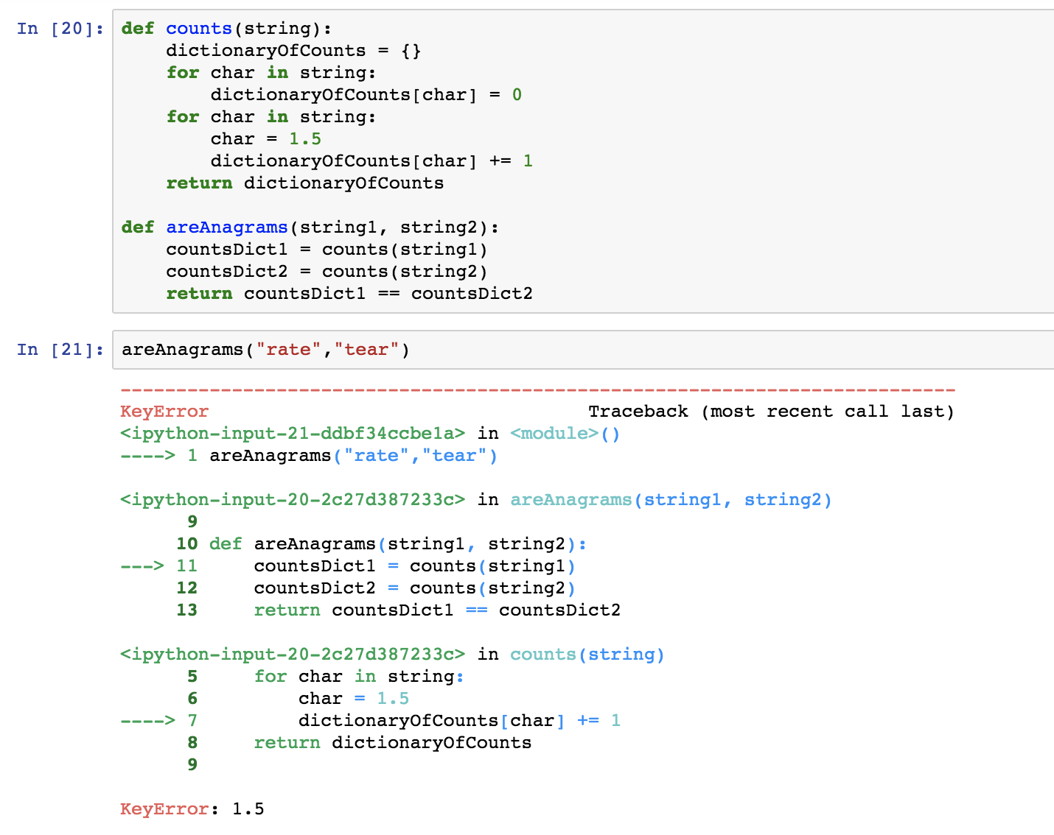
Bug here
Notes:
So say if there’s a bug in my function definition. Everything might look fine until I actually call the function.

Slide 25
Scope
Notes:
So naturally you can visualize a function as code that gets copy/pasted everywhere
But using a function isn’t exactly the same as copy/pasting code everywhere

Slide 26
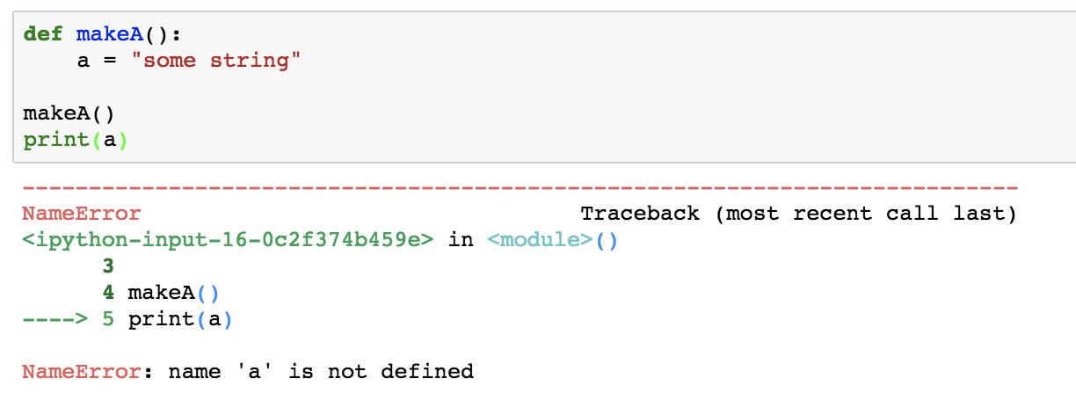
Notes:
So an important thing to notice about functions, is that any variable you create inside them gets destroyed when the function finishes.

Slide 27
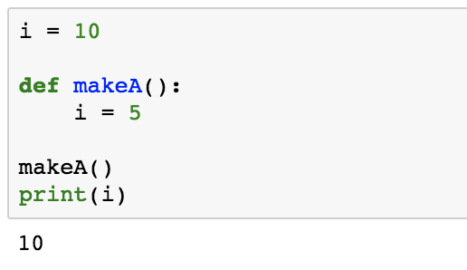
Global Variable
Local Variable
Notes:
These variables, are what we call “local variables.” They exist inside the function, and are independent of what’s outside of the functions. The global variables exist everywhere outside of the function, but get ignored inside the function.

Slide 28
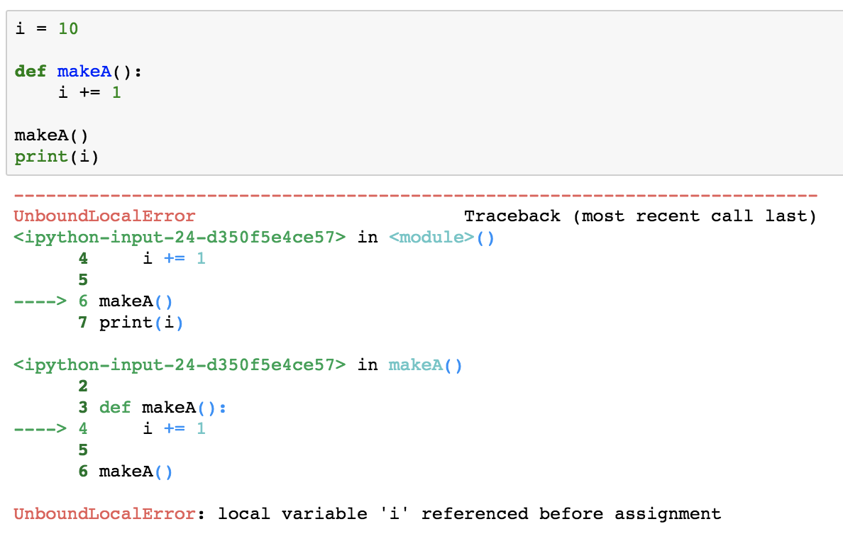
Notes:
So notice that Python complains that I am trying to access ”i” without permission.

Slide 29
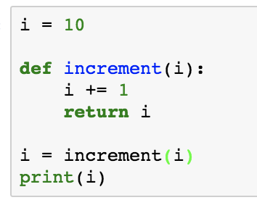
Notes:
So if I want the function to do something with “i”, I have to pass the variable as input into the function. And if I want to store the value that I end up with, I should return that value.

Slide 30
Scope
”Local Variables” vs. ”Global Variables”
– A function can’t change “global variables”
– All “local variables” are destroyed. You only get to keep your return value.
Notes:
So, reviewing scope:
Variables initialized inside a function are called ”local variables.” Variables initialized outside of functions are “global variables.”
A function, by default, can’t change global variables. It must receive the global variables as input.
When the function is finished, the “local variables” are destroyed, and the only thing you get to keep is what the function returns.

Slide 31
Function Exercise Challenges
Write a function that takes two lists, and returns a list of common elements between the two.
Use loops to calculate the factorial of a number. Write a function that calls itself to calculate the factorial of the input. Which was easier for you?

Slide 32
Notes:
You can

Slide 33
Notes:
You can

